Slide 1





Farmington Hill Salesforce Developer Group
Salesforce Apex Hours
Topic Name
Speaker
Date
Venue/Link
Your Name
Saturday, JAN 11, 2020 10:00 AM EST ( 8:30 PM IST )
Online
#SalesforceApexHours
www.apexhours.com
#SalesforceApexHours

Slide 2
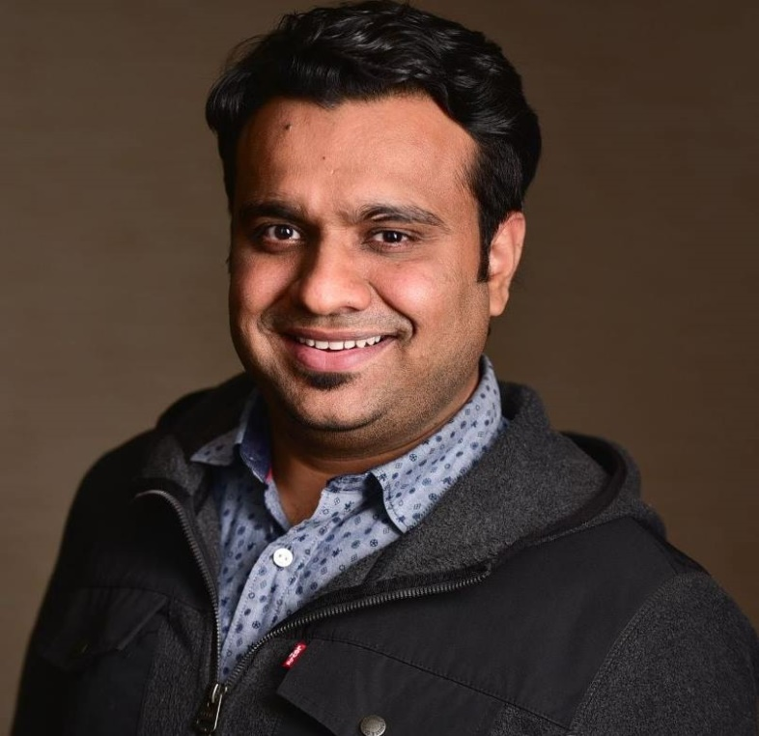
Who I am
Amit Chaudhary (Salesforce MVP)
Active on Salesforce Developer Community
Blogging at http://amitsalesforce.blogspot.in/
Co-Organizer of – FarmingtonHillsSFDCDug
Founder of www.ApexHours.com
Follow us @Amit_SFDC or @ApexHours

Slide 3
Upcoming session
Become an Order of Execution Hero on JAN 18, 2020 10:00 AM EST (8:30 PM IST) with Daniel Stange and Marc B. Kirsch
Salesforce integration Pattern & Best Practices on FEB 1, 2019 10:00 AM EST (8:30 PM IST) with Jitendra Zaa
Microservices in Salesforce on FEB 22, 2020 10:00 AM EST (8:30 PM IST) with Jigar Shah
RSVP Here : http://www.apexhours.com/sessions-in-2020/

Slide 4
Our Speaker
Your Name
Your Detail

Slide 5
Agenda

Slide 6





Heading text goes here
#SalesforceApexHours @ApexHours
www.ApexHours.com
https://trailblazercommunitygroups.com/farmington-mi-developers-group/
https://www.youtube.com/channel/UChTdRj6YfwqhR_WEFepkcJw/videos
https://www.facebook.com/FarmingtonHillsSfdcdug/?ref=bookmarks

